Slide 1
APUSH Review: Key Concept 4.1
www.Apushreview.com
Period 4: 1800 – 1848
Everything You Need To Know About Key Concept 4.1 To Succeed In APUSH
Updated for the 2015 revisions

Slide 2
The New Curriculum
Key Concept 4.1 “The United States began to develop a modern democracy and celebrated a new national culture, while Americans sought to define the nation’s democratic ideals and change their society and institutions to match them.”
Page 44 of the Curriculum Framework
Big ideas:
What were the reasons for the development of political parties, and characteristics of each party?
How did the Second Great Awakening impact America?
How did slaves adapt to their circumstances and create a new culture?

Slide 3
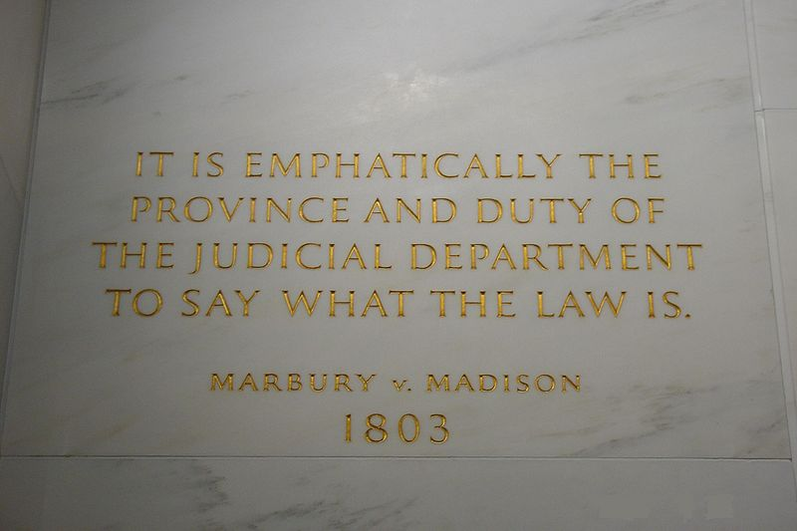
Key Concept 4.1 I
“The nation’s transition to a more participatory democracy was achieved by expanding suffrage from a system based on property ownership to one based on voting by all adult white men, and it was accompanied by the growth of political parties.” – page 44 of the curriculum framework
A. Political Parties in the early 1800s (Federalists and Jeffersonians)
Federalists: favored stronger central government, supported by upper-class, merchants and bankers, and Pro-British, loose interpretation of the Constitution
Democratic-Republicans: states-rights, supporter by lower and middle classes, farmers, Pro-French, strict interpretation of the Constitution
Both parties developed out of Hamilton’s Financial Plan and the French Revolution
B. The Supreme Court strengthened the power of the federal government, often at the expense of state governments:
Marbury v. Madison – established the principle of judicial review
McCulloch v. Maryland – upheld constitutionality of 2nd BUS, federal government given more power of states
Gibbons v. Ogden – Congress, NOT states can control interstate commerce

Slide 4
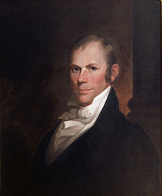
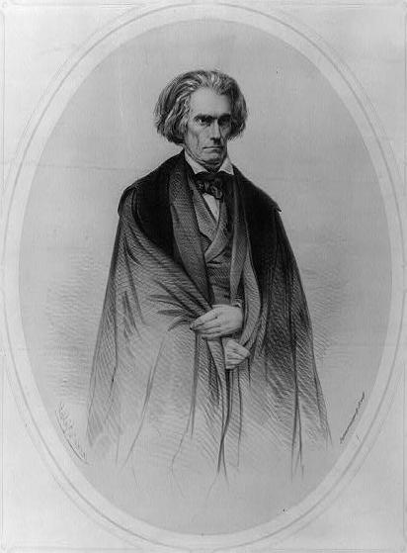
Key Concept 4.1 I
C. Democrats and Whigs
Democrats: Led by Andrew Jackson, the “Common Man”: against BUS and the American System
Whigs: (Henry Clay!) Anti-Andrew Jackson; favored stronger federal government, internal improvements, tariffs, and the BUS
D. Regional political and economic loyalties overshadowed national concerns:
Nullification Crisis (1833)– South Carolina and other southern states opposed the Tariffs of 1828 and 1832; South Carolina even nullified those tariffs
South Carolina threatened to secede if Jackson collected the tariff by force
Webster’s 2nd Reply to Hayne – Webster promoted nationalism over sectionalism

Slide 5
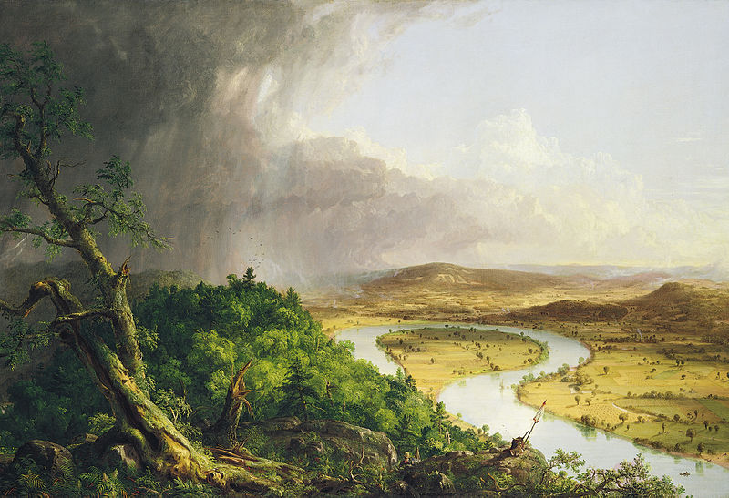
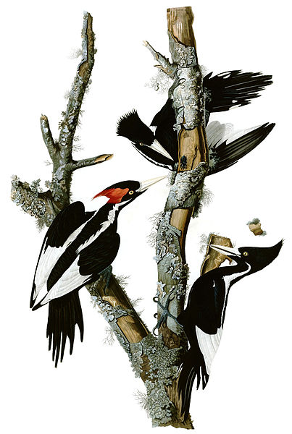
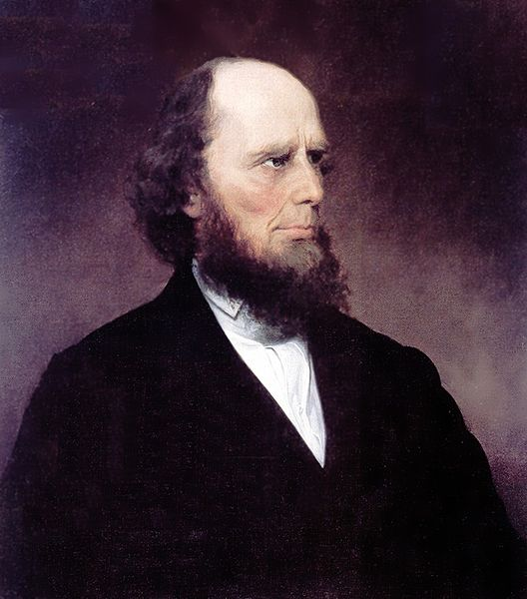
Key Concept 4.1 II
“While Americans embraced a new national culture, various groups developed distinctive cultures of their own.” – page 45 of the curriculum framework
A. The 2nd Great Awakening sought to inspire humans to achieve perfection:
Charles G. Finney – massive sermons to convert individuals
Utopian Societies – social experiments that hoped to achieve perfection in communities – Oneidas, Brooke Farm, etc.
Inspired other reform movements:
Temperance, Abolitionism
B. The emergence of a new national culture
Was a combination of European and local culture
New American Art, literature, and architectural ideas emerged
Examples: John James Audubon – made significant contributions to the study of birds – prints of birds
The Hudson River School – focused on landscape paintings; believed nature was a great source of wisdom and inspiration

Slide 6
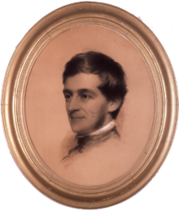
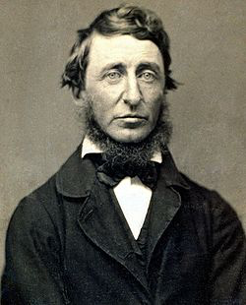
Key Concept 4.1 II
C. Literature, art, philosophy, and architecture reflected a belief in human perfectibility
Transcendentalism – 1830s movement that encouraged individuals to have communication with God and nature
Ralph Waldo Emerson – Self-Reliance – individuals should follow self interests
Henry David Thoreau – Walden, Civil Disobedience
D. Enslaved African Americans created communities and sought to protect their family structures and dignity
African Americans developed “surrogate” families
When families were separated via slavery, others would look after family members
Slave music – used to help pass the time while working
Instrumental part of religious services

Slide 7
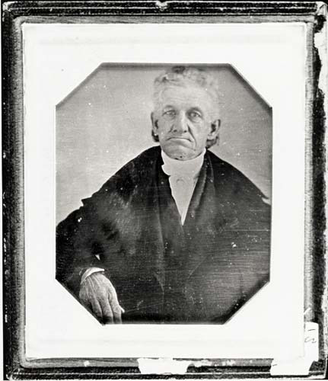
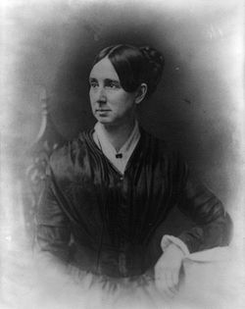
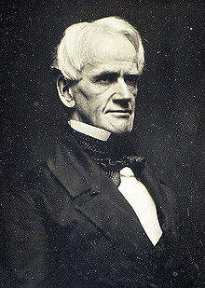
Key Concept 4.1 III
“Increasing numbers of Americans, many inspired by new religious and intellectual movements, worked primarily outside of government institutions to advance their ideals.” – page 46 of the curriculum framework
A. Organizations that attempted to improve society and individual behavior
American Temperance Society:
Co-founded by Lyman Beecher (Harriet Beecher-Stowe’s father)
Created 1,000s of chapters throughout the US
Aligned with the abolitionist movement
Dorothea Dix – sought to improve treatment for the mentally ill
Horace Mann – “Father of Education”
Shakers - practiced celibacy,; believed in sexual equality

Slide 8
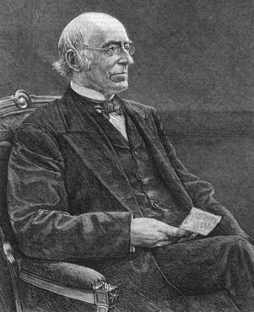
Key Concept 4.1 III
B. Abolitionist and Anti-Slavery Movements
Achieved success in the North – many northern states gradually emancipated slaves
Was an increasing number of free African Americans in the North AND the South:
Eventually, many states made it illegal for slave owner to manumit (free) their slaves
Antislavery in the South:
Gag-order – prohibited the introduction of abolitionist bills in the House of Reps
Unsuccessful rebellions in the South:
Denmark Vesey (1820): largest planned rebellion, never materialized
Vesey and followers were hanged -> more strict slave laws
Nat Turner’s Rebellion (1831):
Rebellion in VA, freed slaves and killed whites on plantations
100s of blacks killed in retaliation (some of which had nothing to do with rebellion)
Coincided at the same year as William Lloyd Garrison’s The Liberator
Called for the immediate and uncompensated end to slavery
C. Women’s Rights Movement:
Often connected to the abolitionist movement
Hoped to achieve greater equality
Seneca Falls Convention: women’s rights convention in NY - Elizabeth Cady Stanton and Lucretia Mott
Attended by Frederick Douglass

Slide 9
Test Tips
Multiple-Choice and Short Answer Questions:
Examples of court cases that increased the power of the federal government
Characteristics of political parties
Organizations and individuals that sought to improve society
Ways slaves resisted their condition
Essay Questions:
Issues that led to the creation of political parties
Impact of the 2nd Great Awakening on American society

Slide 10

See You Back Here For Key Concept 4.2!
Thanks for watching
Please subscribe and share
Good luck in May
You’re brilliant!

